Slide 1
University of Victoria
Welcome to the Camosun College and University of Victoria Nursing (BSN) Program Information Session

Slide 2
Territorial Acknowledgement
Camosun College respectfully acknowledges that our campuses are situated on the territories of the Lək̓ʷəŋən (Songhees and Kosapsum) and W̱SÁNEĆ peoples. We honour their knowledge and welcome to all students who seek education here.

Slide 3
Camosun College
Camosun College is B.C.’s largest public college
19,000+ students
1,200+ faculty and staff
Programs range from arts and business to tech and trades and university transfer
Credentials include dual credits, certificates, diplomas, degrees, post-degree diplomas

Slide 4
School of Health & Human Services (HHS)
Camosun College offers more than 15 health and human services programs, including degrees, post-degree diplomas, certificates, diplomas and university transfer courses.
Our School, the School of Health and Human Services (HHS) is a place of warmth and caring.
Our goal is to educate and support “flourishing Individuals, families and communities”.

Slide 5
Centre for Health and Wellness (CHW)
All Health and Human Service (HHS) Programs except Dental are delivered at the Centre for Health and Wellness (CHW) at Interurban Campus
The CHW brings together HHS Programs and allows a more interdisciplinary approach to teaching and learning
The CHW provides twenty-first century learning environments including modern classrooms designed to foster active learning, hands-on labs, high technology simulation environments, and lots of collaboration spaces

Slide 6
Alex & Jo Campbell Centre for Health and Wellness
21st century education for outstanding health and wellness professionals
$63.8 million investment
89,000 sq. ft. facility at Interurban campus
800+ students
Latest in health education teaching
Interdisciplinary approach is aligned with Island Health

Slide 7
Alex & Jo Campbell Centre for Health and Wellness
21st century education for outstanding health and wellness professionals

Slide 8
Definition of a Registered Nurse
The Canadian Nurses Association defines the RN as follows:
RNs are self-regulated health-care professionals who work autonomously and in collaboration with others to enable individuals, families, groups, communities and populations to achieve their optimal levels of health. At all stages of life, in situations of health, illness, injury and disability, RNs deliver direct health-care services, coordinate care and support clients in managing their own health. RNs contribute to the health-care system through their leadership across a wide range of settings in practice, education, administration, research and policy.*
*Retrieved from https://www.cna-aiic.ca/~/media/cna/page-content/pdf-en/framework-for-the-pracice-of-registered-nurses-in-canada.pdf?la=en

Slide 9
What are the differences between different kinds of nursing programs?
Regulated | LPN | RN | RPN | NP
 | 2 year program | 4 year program | 2-4 year program | RN plus graduate degree
Non- regulated | HCA
 | 7 Month Program
HCA – Health Care Assistant LPN – Licensed Practical Nurse
RN – Registered Nurse
RPN – Registered Psychiatric Nurse
NP – Nurse Practitioner

Slide 10
Overview of Program
First 2.5 years at Camosun
Next 1.5 years at UVIC
Years 1 & 2 go from September to June
Year 3 is from September to July
Year 4 is from September to April

Slide 11
Review the BSN program pages online:
Program Overview
Courses
Costs
Note: Program refresh starting in Fall 2025. Course changes not reflected in the 2024-2025 academic calendar

Slide 12
Program Overview
Competitive Entry
Next intake: Fall 2026
Application date: starting in Fall 2025

Slide 13
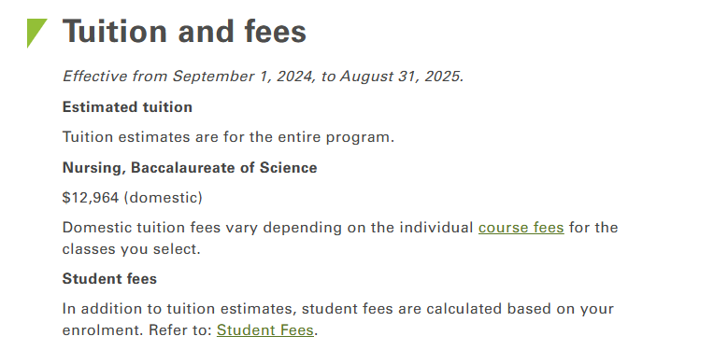
Costs (Approximate)
(At Camosun College only)

Slide 14
Is a career as a Registered Nurse for you?
Strong sense of responsibility and an interest in the health and well- being of individuals, families and communities.
Strong interpersonal, academic, technical and problem-solving skills; and the ability to function both independently and as part of a team.
Physically and mentally demanding profession and registered nurses must be able to cope well in stressful environments.
Respond professionally and knowledgeably to trauma, surgical procedures, and human suffering.
Possess physical fitness—including good eyesight and hearing— and mental acuity.
Competent in written and oral English, be able to accurately follow written instructions, and understand fast paced verbal directions.
Computer fluency is required during the program and eventual employment.

Slide 15
Job Opportunities in Nursing
Acute Care Hospitals
Complex Care Facilities
Community Health
Health Education and Counselling
Federal, Provincial & Municipal Agencies
Occupational Health
First Nations Health
Mental Health
Research
Travel Nursing
Education

Slide 16
Career Building Possibilities
Graduate degrees:
Advanced practice
Educator
Leadership
Informatics
Research
Post-RN continued learning:
OR, ER, ICU, etc.
Advanced certifications
(ie. ACLS)
BSN:
Entry-to-practice
Opportunity for practice
focus in Year 4

Slide 17
Why Camosun College and the University of Victoria Program?
Advantage of attending both institutions and accessing the combined resources available to students.
Faculty with diverse areas of experiences, expertise, education and research.
Strong student peer support network.
Integrated course work with nursing practice.
Wide range of teaching strategies, with a focus on experiential learning
Use of low and high fidelity simulation labs to help integrate theory into practice.
One of the highest number of clinical hours of any nursing program in Canada (~1200 hrs. over 4 years)
Access to a variety of clinical settings in Victoria
Opportunity to go to national and international field schools for clinical placements
Priority Seats for Students with Indigenous Ancestry

Slide 18
Readiness & Preparation for Success
The BSN program is challenging and rewarding.
Can require 3–4 hrs/day of studying and 3-7 hrs/ day of class time.
Are you well organized? It is challenging to catch up if you get behind.
A strong foundation in English, Math and Biology
If possible take your 100-level English, IST 120, and elective ahead of time; if possible, complete both first year biology courses
Financial Aspects
Support Network (family and friends)
Volunteer &/or work experience in the healthcare field

Slide 19
Program Participation Requirements
A negative TB skin test or a negative chest x-ray. Evidence must be dated no more than six months before the program start date. Students are responsible for the cost of testing.
Immunization status, and be prepared to provide proof of vaccination. Students are highly recommended to maintain current immunizations as per the Provincial Practice Education Guidelines: spe.healthcarebc.ca
Standard First Aid and Basic Life Support, including the airway management and oxygen therapy courses. Basic Life Support must be renewed yearly while in the program.
Yearly respirator mask “fit-testing” done. Fitting will be completed in the program.
Criminal Record Check
BC Provincial Violence Prevention Training.

Slide 20
On-line application process
Education Planner website
Next intake: Fall 2026
Application date: starting in Fall 2025

Slide 21
Competitive Admission Process for the annual Fall Intake
Admission information page
Send your questions to:
BSN Admissions Advisor, Deborah Delaney – debdelaney@camosun.ca

Slide 22
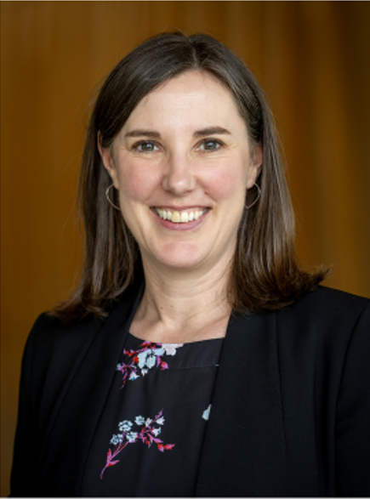
Camosun College offers more than health and human services programs!
The School of HHS is a place of warmth and care.
Our goal is to educate and support “flourishing individuals, families and communities”.
View the Dean’s Welcome and the School of Health & Human Services (HHS)
Student Handbook online
Carly Hall, RN, BSN, MEd
Dean, School of Health and Human Services

Slide 23
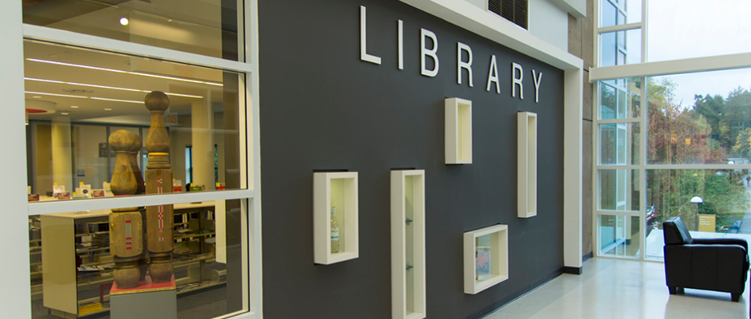
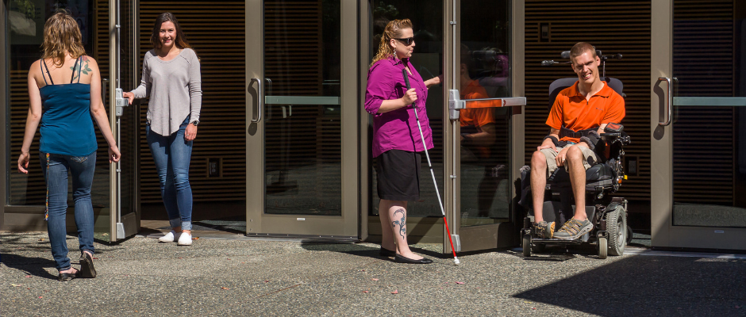
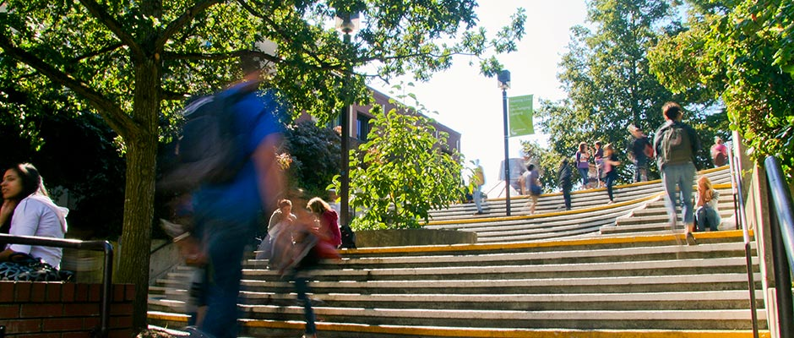
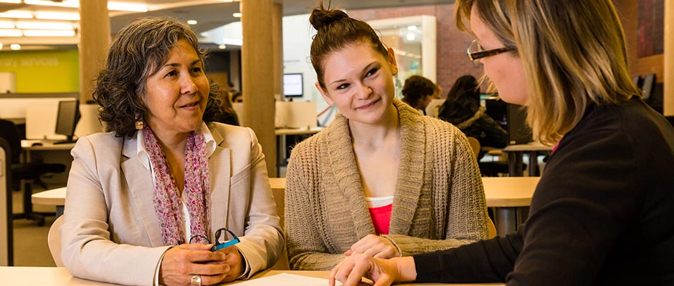
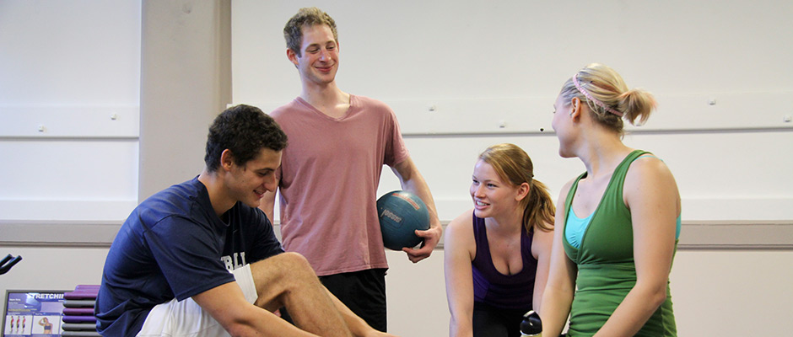
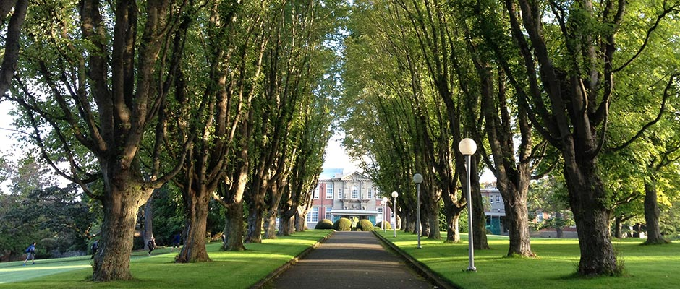
Student Services at Camosun
Admissions & Recruitment
The right start at Camosun
The Writing Centres
How can we help?
Centre for Accessible Learning
Supporting your learning experience
Academic Advising
Guiding you on your educational journey
Academic Upgrading
Whatever your need, we have an option for you
Indigenous Student Support
Find your way and feel like you belong – with our help
Fitness & Recreation
Make time for your well-being
Financial Aid & Awards
Funding your education
Counselling Centre
Supporting you through life’s challenges

Slide 24
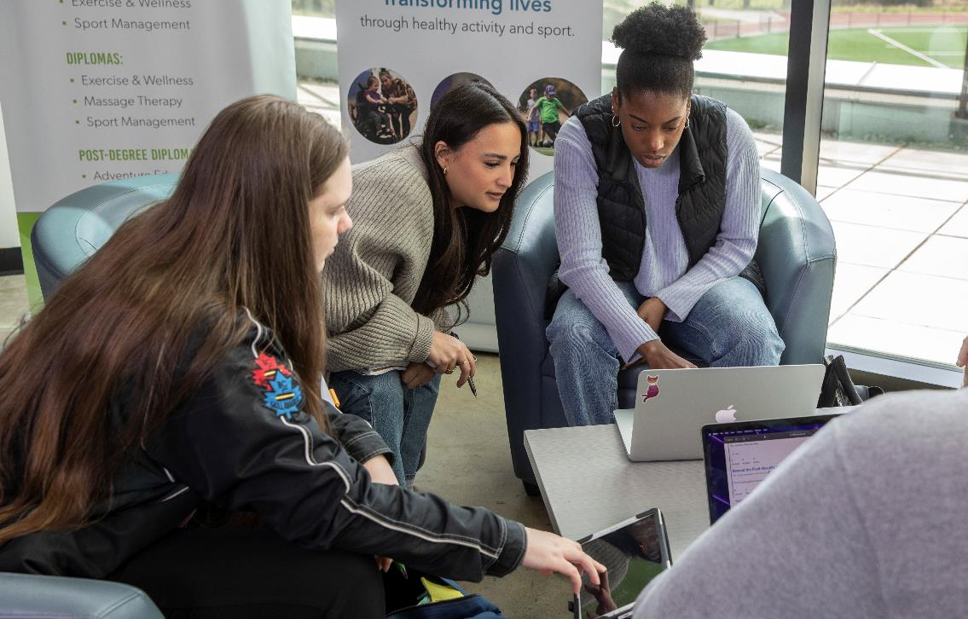
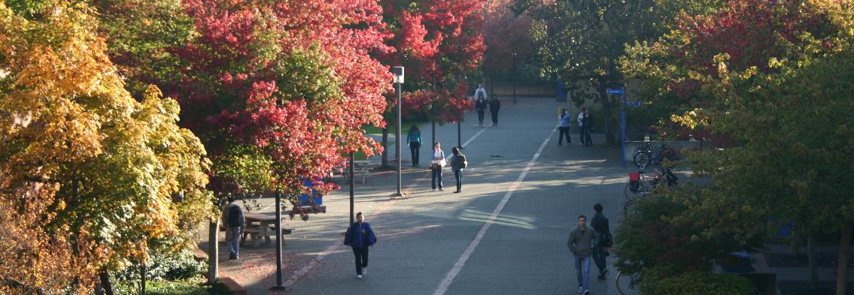
Government Loans/Grants
Camosun Awards & Bursaries
Other Funding

Slide 25
Money You Repay
StudentAid Loans (Provincial/Federal)
Student Loans/Lines of Credit
Money You Don’t Repay
StudentAid Grants (Provincial/Federal/Disability)
Camosun Entrance & School Awards
Camosun Foundation Bursaries
Other Funding
Adult Upgrading Grant
Tuition Waiver Program (for Former Youth in Care)
Indigenous Students
Mature Students

Slide 26
Start now! Make a plan and budget for your
educational journey
4-6 weeks before classes begin Apply for StudentAid, awards and scholarships
Refer to camosun.ca/financialaid for Camosun award and bursary information and put important deadline dates into your calendar

Slide 27
Monday-Friday
9am-4pm
250-370-4862
financialaid@camosun.ca
In person, Interurban Campus Liz Ashton Campus Centre, Second floor
Virtually via iPad, Lansdowne Campus Dawson Building, First floor

Slide 28
Thank you
Inspiring life-changing learning
FOR MORE INFORMATION:
Course Requirements and Prerequisites | BSN Admissions Advisor, Deb Delaney | DebDelaney@camosun.ca
BSN Program Questions | BSN Chair, Robin Humble | Humbler@camosun.ca

